Slide 1
P589-1 Refined hashtag processing initial clustering, annotated umaps
Thomas H. Edwards
20240718

Slide 2
Cells passing qc for each hashtag
hashtag | pool | donorId | stimulation | nCells_passQC
CerosalettiLab1059994_CD3CD28 | 2 | CerosalettiLab1059994 | CD3CD28 | 42
CerosalettiLab1059994_CEFX | 2 | CerosalettiLab1059994 | CEFX | 1437
CerosalettiLab1059994_Islet | 2 | CerosalettiLab1059994 | Islet | 114
CerosalettiLab1464776_CD3CD28 | 2 | CerosalettiLab1464776 | CD3CD28 | 160
CerosalettiLab1464776_CEFX | 2 | CerosalettiLab1464776 | CEFX | 1884
CerosalettiLab1464776_Islet | 2 | CerosalettiLab1464776 | Islet | 153
CerosalettiLab448473_CD3CD28 | 1 | CerosalettiLab448473 | CD3CD28 | 493
CerosalettiLab448473_CEFX | 1 | CerosalettiLab448473 | CEFX | 3111
CerosalettiLab448473_Islet | 1 | CerosalettiLab448473 | Islet | 240
CerosalettiLab632811_CD3CD28 | 1 | CerosalettiLab632811 | CD3CD28 | 604
CerosalettiLab632811_CEFX | 1 | CerosalettiLab632811 | CEFX | 1334
CerosalettiLab632811_Islet | 1 | CerosalettiLab632811 | Islet | 388
CerosalettiLab839987_CD3CD28 | 1 | CerosalettiLab839987 | CD3CD28 | 279
CerosalettiLab839987_CEFX | 1 | CerosalettiLab839987 | CEFX | 8612
CerosalettiLab839987_Islet | 1 | CerosalettiLab839987 | Islet | 263
CerosalettiLab942655_CD3CD28 | 2 | CerosalettiLab942655 | CD3CD28 | 439
CerosalettiLab942655_CEFX | 2 | CerosalettiLab942655 | CEFX | 12609
CerosalettiLab942655_Islet | 2 | CerosalettiLab942655 | Islet | 244

Slide 3
Pool 1 hashtag expression with cutoffs

Slide 4
Pool 2 hashtag expression with cutoffs

Slide 5
Pool1 hashtag ridgeplots

Slide 6
Pool2 hashtag ridgeplots

Slide 7
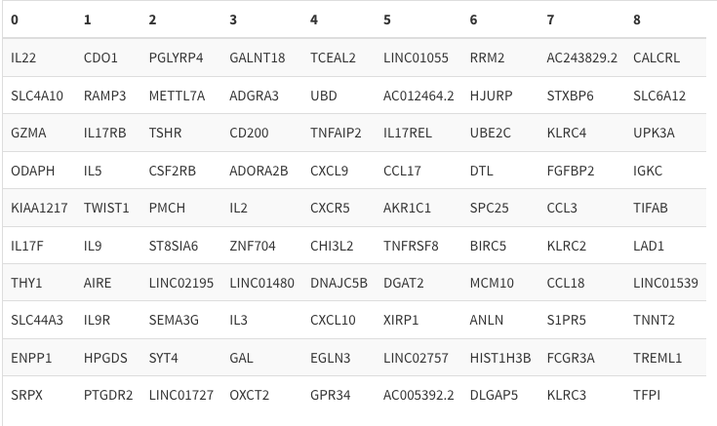
RNA umap – unintegrated

Slide 8
Rna umap clusters

Slide 9
Study group

Slide 10
Study group

Slide 11
stimulation

Slide 12
stimulation

Slide 13
Donor id, warm colors are t1d, cool colors control

Slide 14
Donor id, warm colors are t1d, cool colors control

Slide 15
Donor id on rna clusters

Slide 25
In progress
Integration by donorId
Downsampling CerosalettiLab942655_CEFX
Demultiplexing CITE-seq feature barcodes
Expression of Treg/Tconv DEGs from P390
Examine vs 137/154 FBs
Optimization of clustering hyperparameters
Cell type inference from RNAseq
iNKT/MAIT cell checks

